Slide 1
Table Look-up
Scrambler
10101101
00101001
10010100
Round 1
+
Table Look-up
Round 2
+
Table Look-up
01010100
Scrambler
00101010
10100010
Scrambler
01000101

Slide 2
1
2
7
4
3
6
5

Slide 3
1
3
1
13
2
11
S1
5
6
R1
8
R2
S2
7
9
10
3
12
2
4
14
4

Slide 4
1
3
S1
1
R1
2
3
R2
4
S2
2
4

Slide 5


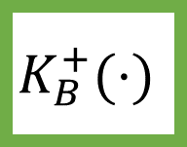

$$m$$
+
$$H(⋅)$$
$$S$$
+
$$K_{B}^{+}(⋅)$$

